Slide 1

Will the Circle Be Unbroken?
Lyrics by: Ada R. Habershon, 1907
Music by: Charles H. Gabriel, 1907
Notes:
Downloaded from: https://hymncommons.org

Slide 2
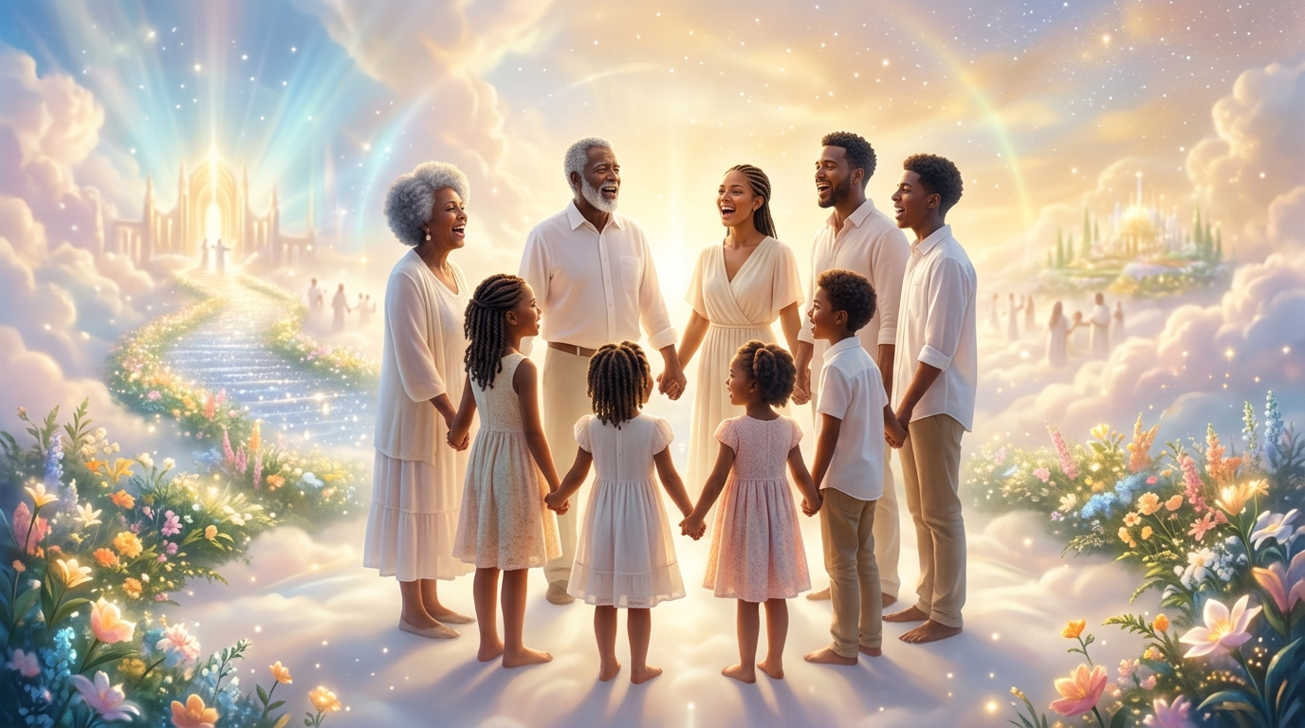
Verse 1
There are loved ones in the glory
Whose dear forms you often miss,
When you close your earthly story
Will you join them in their bliss?
Will the circle be unbroken
By and by, by and by?
Is a better home awaiting
In the sky, in the sky?

Slide 3

Verse 2
In the joyous days of childhood,
Oft they told of wondrous love
Pointed to the dying Savior,
Now they dwell with Him above.
Will the circle be unbroken
By and by, by and by?
Is a better home awaiting
In the sky, in the sky?

Slide 4
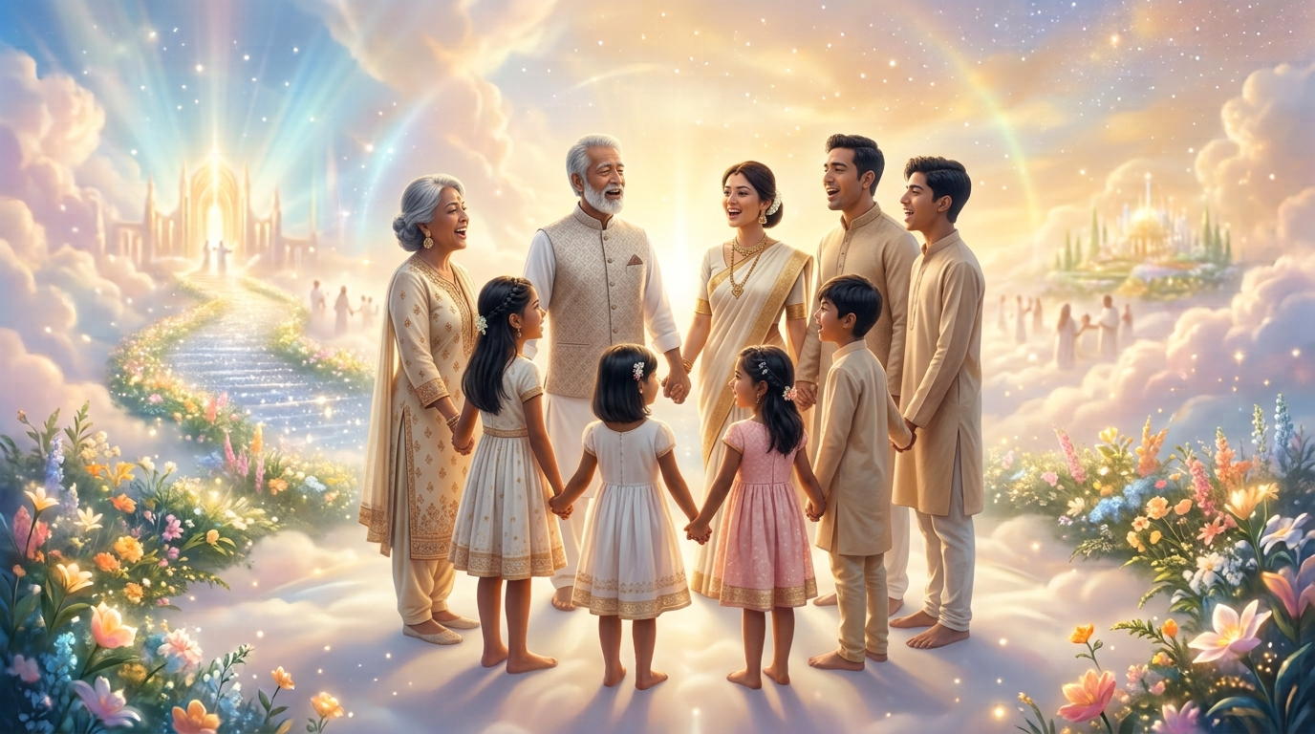
Verse 3
You remember songs of heaven,
Which you sang with childish voice,
Do you love the hymns they taught you,
Or are songs of earth your choice?
Will the circle be unbroken
By and by, by and by?
Is a better home awaiting
In the sky, in the sky?

Slide 5
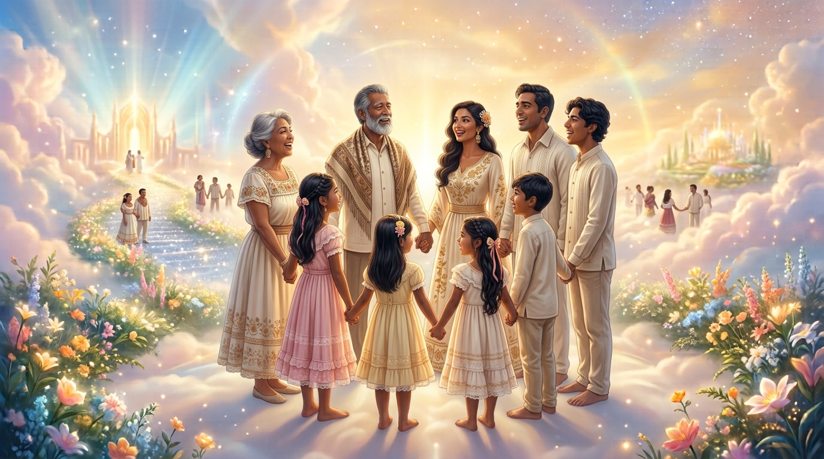
Verse 4
You can picture happy gath'rings
Round the fireside long ago,
And you think of earthly partings,
When they left you here below.
Will the circle be unbroken
By and by, by and by?
Is a better home awaiting
In the sky, in the sky?

Slide 6
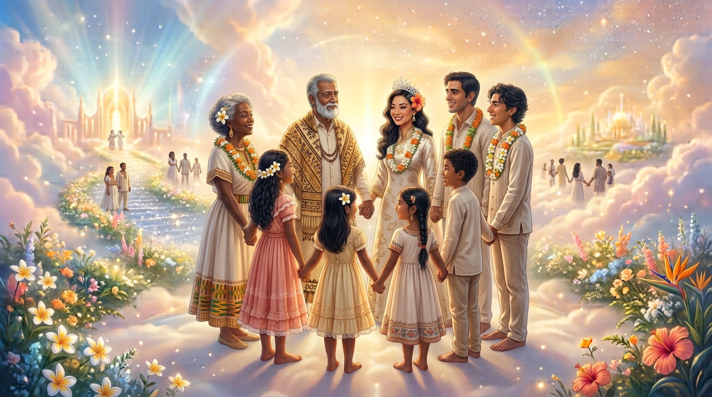
Verse 5
One by one their seats were emptied,
One by one they went away,
Now the family is parted,
Will it be complete one day?
Will the circle be unbroken
By and by, by and by?
Is a better home awaiting
In the sky, in the sky?

